Slide 1
Double Point of Development
Body paragraph

Slide 2
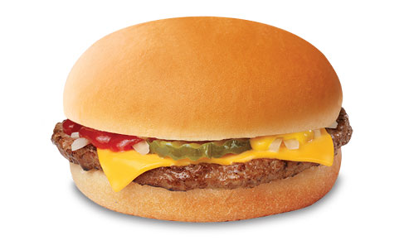
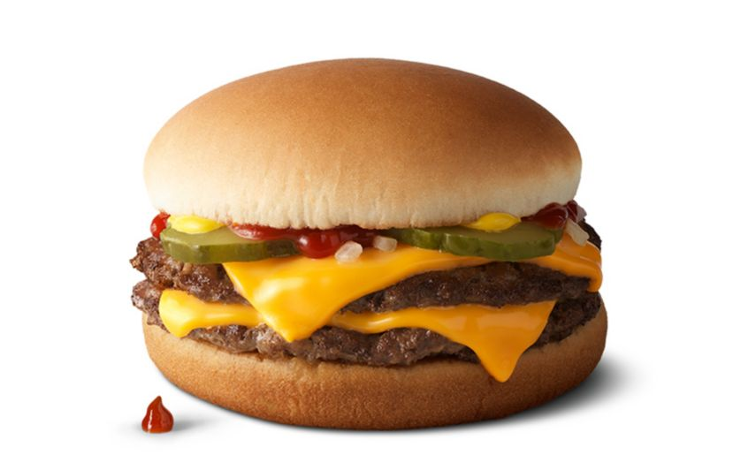
What is different? What’s in common?
VS

Slide 3
When you are proving a point --
Use textual evidence, paraphrased or directly quoted
But wouldn’t it be stronger to use 2 pieces of evidence instead of just one?
If I want to describe my relationship with my sister by saying it’s “supportive,” but I can only provide ONE example, that isn’t very compelling.

Slide 4
Adding a second example
So where do we add a second (or third) piece of evidence?
Inside the structure we already have!

Slide 5
Body Paragraph –
The EV, CM, CM part of our paragraphs (think of the meat and cheese in a burger) are referred to as the POINT OF DEVELOPMENT
The author develops their point, by citing evidence and explaining it
TS EV CM CM EV CM CM CS

Slide 6
Clarifications
This is still ONE paragraph, even if it is longer than most.
There is still only ONE topic sentence, which means that both pieces of evidence relate to the same claim
These are the types of paragraphs you will write in AP Lang and Lit.

Slide 7
Example
Let’s think about the Cronkite Analysis.
TS EV CM CM EV CM CM CS
The first paragraph explores the uncertainty of an American victory by using terms that relate to doubt.

Slide 8
Example
Let’s think about the Cronkite Analysis.
TS EV CM CM EV CM CM CS
The first paragraph explores the uncertainty of an American victory by using terms that relate to doubt. Cronkite explains “who won and who lost” in the form of a question, adding that even he is “not sure.”

Slide 9
Example
Let’s think about the Cronkite Analysis.
TS EV CM CM EV CM CM CS
The first paragraph explores the uncertainty of an American victory by using terms that relate to doubt. Cronkite explains “who won and who lost” in the form of a question, adding that even he is “not sure.” To have a trusted and unbiased newscaster tell the American public that not even he is certain about the outcome of a series of battles throws doubt into further involvement. It also allows Cronkite’s audience, who still mostly favors the war, to see that they could be wrong without having to abandon their belief in the virtue of democracy.

Slide 10
Example
Let’s think about the Cronkite Analysis.
TS EV CM CM EV CM CM CS
The first paragraph explores the uncertainty of an American victory by using terms that relate to doubt. Cronkite explains “who won and who lost” in the form of a question, adding that even he is “not sure.” To have a trusted and unbiased newscaster tell the American public that not even he is certain about the outcome of a series of battles throws doubt into further involvement. It also allows Cronkite’s audience, who still mostly favors the war, to see that they could be wrong without having to abandon their belief in the virtue of democracy. In that same paragraph the word “standoff” is repeated three times, taking on the symbolic meaning of a war with no winner.

Slide 11
Example
Let’s think about the Cronkite Analysis.
TS EV CM CM EV CM CM CS
The first paragraph explores the uncertainty of an American victory by using terms that relate to doubt. Cronkite explains “who won and who lost” in the form of a question, adding that even he is “not sure.” To have a trusted and unbiased newscaster tell the American public that not even he is certain about the outcome of a series of battles throws doubt into further involvement. It also allows Cronkite’s audience, who still mostly favors the war, to see that they could be wrong without having to abandon their belief in the virtue of democracy. In that same paragraph the word “standoff” is repeated three times, taking on the symbolic meaning of a war with no winner. Cronkite argues that while the war continues, it costs American lives, so it cannot be predicated on doubt of victory. This standoff is an uncomfortable end, but that is the one that he believes Americans are heading towards.

Slide 12
Example
Let’s think about the Cronkite Analysis.
TS EV CM CM EV CM CM CS
The first paragraph explores the uncertainty of an American victory by using terms that relate to doubt. Cronkite explains “who won and who lost” in the form of a question, adding that even he is “not sure.” To have a trusted and unbiased newscaster tell the American public that not even he is certain about the outcome of a series of battles throws doubt into further involvement. It also allows Cronkite’s audience, who still mostly favors the war, to see that they could be wrong without having to abandon their belief in the virtue of democracy. In that same paragraph the word “standoff” is repeated three times, taking on the symbolic meaning of a war with no winner. Cronkite argues that while the war continues, it costs American lives, so it cannot be predicated on doubt of victory. This standoff is an uncomfortable end, but that is the one that he believes Americans are heading towards. The uncertainty is this paragraph paves Cronkite’s way to next demonstrating that further shows of power would be even more destructive.

Slide 13
Yep, that’s a long paragraph.

Slide 14
Getting it Right
Remember, this is one paragraph.
If the TOPIC SENTENCE has a claim and reasoning, then it should match for both examples.
Let me give you some GOOD examples:

Slide 15
Good Examples
TS: Orwell uses chocolate to symbolize Winston’s desire for love.
P.O.D. ONE
EV: Quote about Mother giving up her share
CM: Explain the self-sacrifice in motherly love
CM: Winston’s inability to “share” that love in an immature and selfish way

Slide 16
Good Examples
TS: Orwell uses chocolate to symbolize Winston’s desire for love.
P.O.D. TWO
EV: Julia brings Winston chocolate
CM: Need for romantic love and friendship that Winston has been lacking
CM: Their commitment to each other showing their true feelings

Slide 17
Good Examples
TS: Julia is clever whereas Winston is wise, demonstrating that practicality is superior when it comes to taking risks.
P.O.D. ONE
EV: Julia recognizes more about the party than Winston does like the “war not being real”
CM: She is young, but being raised in this world makes her more insightful about the true dangers in it.
CM: Her risk-taking is small but enhances her own life in a selfish, but ultimately much more safe way.

Slide 18
Good Examples
TS: Julia is clever whereas Winston is wise, demonstrating that practicality is superior when it comes to taking risks.
P.O.D. ONE
EV: Winston is concerned with “history” and creating a record for the “future”
CM: Winston’s curiosity is their downfall because of his desire reach beyond his own comfort/ happiness
CM: By seeking ways to change society, he is the one who endangers both of them.

Slide 19
Good Examples
TS: Robert Frost uses onomatopoeia to enhance the setting by showing its inherent dangers.
I’d need two quotes with what device?
They BOTH need to be about what?

Slide 20
Good Examples
TS: Shakespeare uses dramatic irony to highlight Iago’s deception
I’d need two quotes with what device?
They BOTH need to be about what trait?

Slide 21
The tricky part
You don’t have to find TWO identical devices.
Diction or Patterns in language can be developed too.

Slide 22
What could I call these?
Let’s say I want to use these quotes from a poem about blackberries:
“glossy purple clot”
“flesh was sweet”
“summer's blood was in it”
“big dark blobs burned/ Like a plate of eyes”
How could I categorize them?

Slide 23
What to avoid
You should still only make one point.
The author uses metaphor and diction to show how the emotions of love and hate can co-exist
are often complicated.

Slide 24
What to avoid
You still should go in order.
I can’t pick metaphor and then go into “We are Mired in a Stalemate,” finding one in each paragraph.
“referees of history” is there for a completely separate reason than war strategists finding “silver linings in the darkest clouds”
By the end of the essay, I will have backtracked several times.

Slide 25
Instead…
Don’t move through devices. Move through ideas.
Two points of development means that ideas can BUILD on top of each other. Each device proves a different point about a single topic sentence.
Remember, it’s still just ONE hamburger.

