Slide 1
STAAR
Myth-Busters

Slide 2
FACT: Reading and Writing Basically Count the Same

Slide 3
The number of questions for each category, taking out the ECR, and adjusting for questions that are 2 points in Reading, we can see that Writing MC questions weigh only slightly more than Reading MC. (1.04 to 1)

Slide 4
In other words, there are fewer Writing MC questions, but with the essay, they weigh the same as the Reading section. SPEND AN EQUAL AMOUNT OF TIME ON EACH

Slide 5
Now,
Let’s look at
READING

Slide 6
Fact: STAAR will test your stamina by giving you long questions and answer choices

Slide 7
MYTH: You can pass without reading the passages Let’s say I had a question about who was the HARDEST WORKER….

Slide 8
If I keep reading, I see that Timmy isn’t working because he’s sick. Heather may be off task because she’s helping.

Slide 9
FACT: I still don’t understand who works harder because I need to read the whole passage

Slide 10
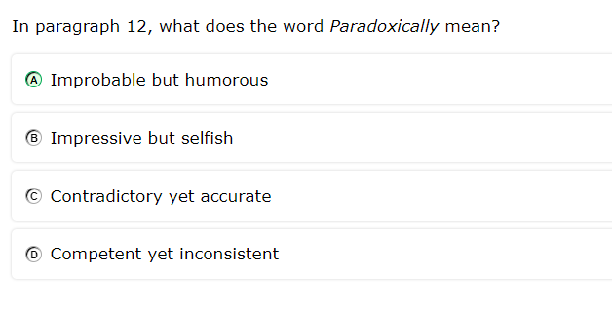
Myth: This is NOT a dictionary question

Slide 11
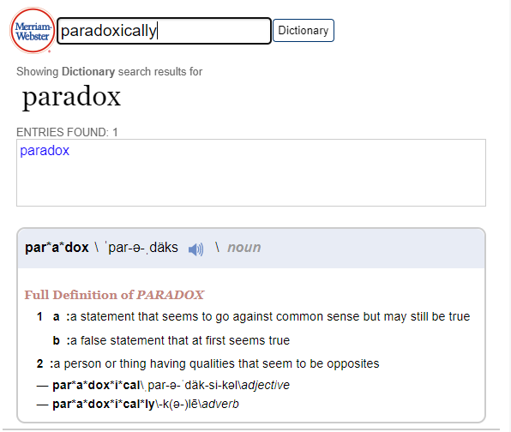
FACT: Looking up the word will make it clear. I.e. STAAR won’t ask you to define words in context that are used incorrectly.

Slide 12
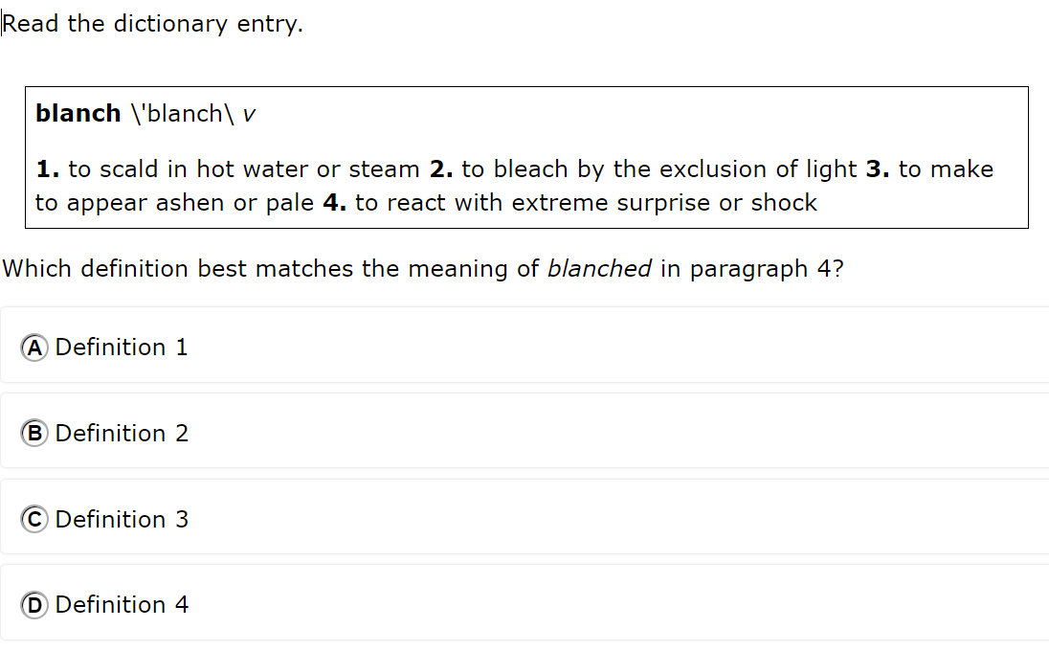
FACT: However, there will be questions where the dictionary won’t help. These are true “vocab in context.”

Slide 13
Fact: STAAR will give you vocabulary questions that don't look like vocabulary questions
Myth: STAAR is smart; therefore, the right answer has the biggest words. (Here it is B).

Slide 14
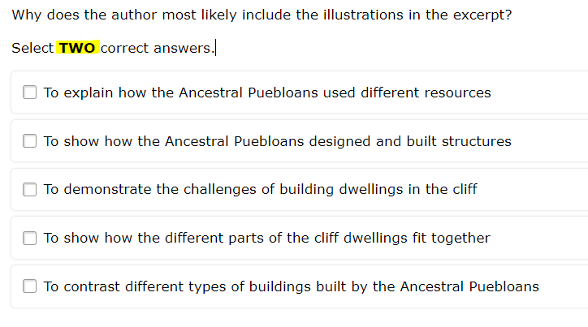
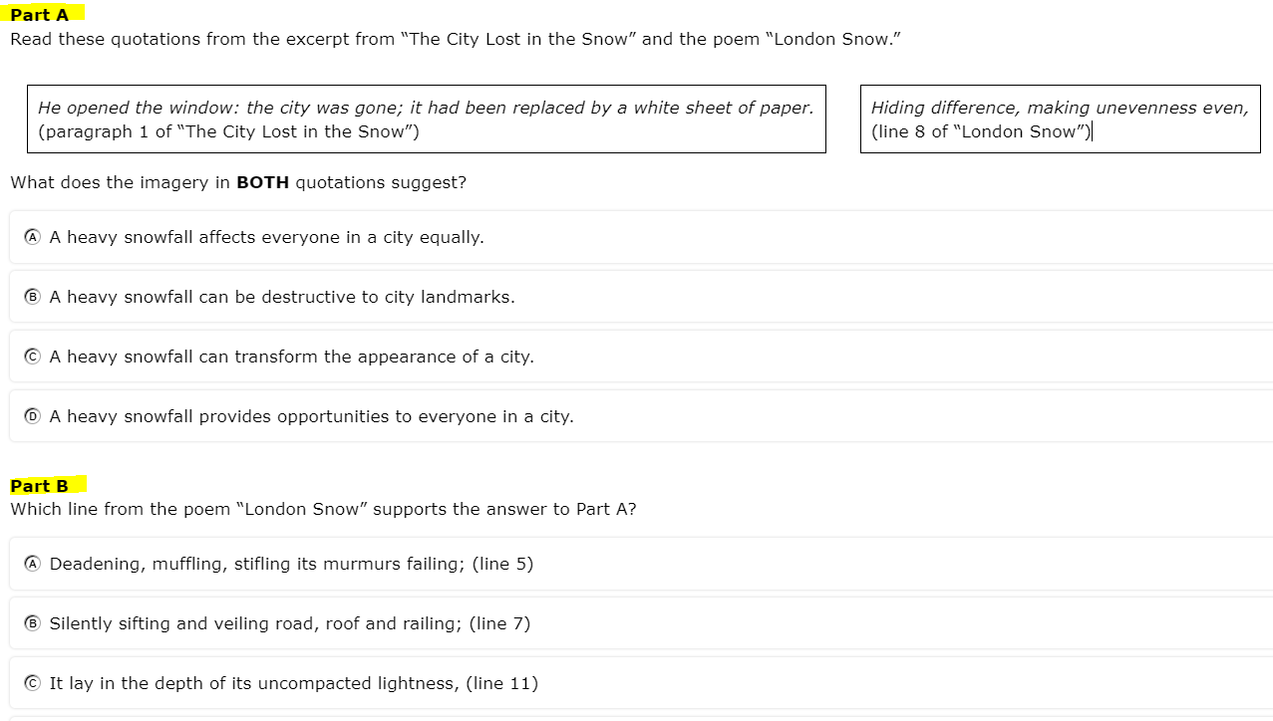
MYTH: You cannot earn partial credit

Slide 15
FACT: These are each worth 2 points on the test

Slide 16
MYTH: Most of the questions are pretty basic. You can skim and get it right.

Slide 17
FACT: If you skim, you’ll fall into intentionally designed traps
When I skim, I see YEARS, which could cause me to select “A”

Slide 18
FACT: If you skim, you’ll fall into intentional traps
But close reading reveals this is mostly about the SKILLS of the Puebloans

Slide 19
FACT: Many of the questions ask you to go beyond WHAT and explain WHY and HOW. STAAR calls this understanding the “author’s craft” or skill.
This single question asks the tester to understand setting, culture influences in that setting, character attitude (before and after being influenced), AND how they are related.

Slide 20
In short, READ THE PASSAGES.

Slide 21
Fact: STAAR likes to see if you can tell what an author believes

Slide 22
Which of these most describes a “belief”?

Slide 23
Now,
Let’s look at
WRITING

Slide 24
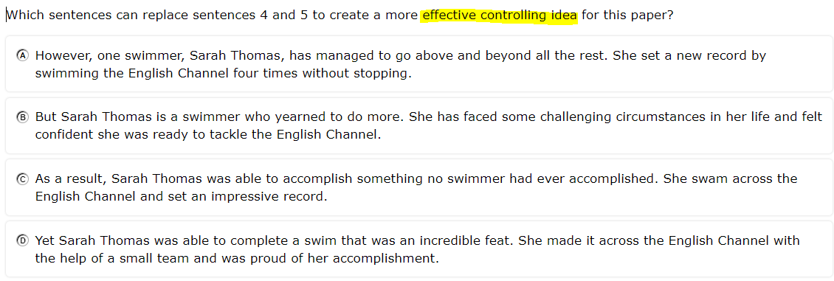
Myth: You don’t need to read the passages

Slide 25
Fact: I cannot revise the THESIS unless I understand the whole paper.

Slide 26
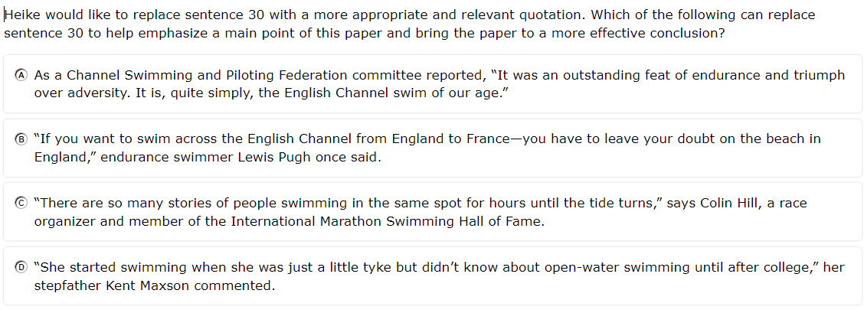
Myth: Sometimes, there is more than one right answer

Slide 27
Fact: Reading the complete question will give you clues

Slide 28
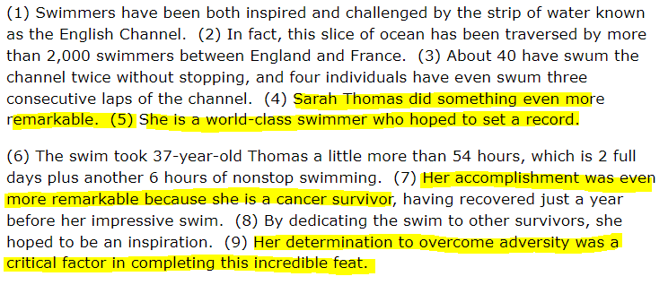
Fact: Reading the complete question will give you clues

Slide 29
Fact: Reading the complete question will give you clues

Slide 30
Fact: Reading the complete question will give you clues

Slide 31
Fact: Reading the complete question will give you clues

Slide 32
Fact: STAAR likes introductory clauses

Slide 34
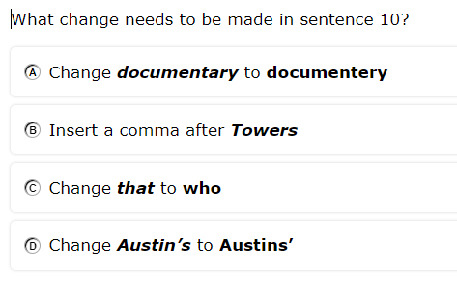
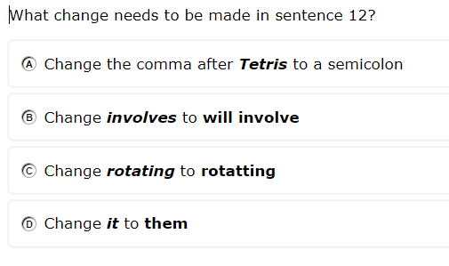
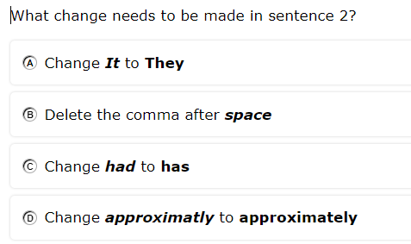
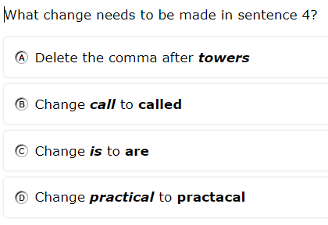
Fact: You must check spelling in the dictionary
These are all from ONE test!

